Slide 1





CST8390_020
Crime Trends in New York City
Presented By:
Group 13
to:
Prof. Grace Pauly

Slide 2




Members
Ved Patel (041095249)
Isha Gadani (041085940)
Guntas Singh Chugh (041091309)
Prince Khakhriya (041133835)
Hamza El Sousi (040982818)
Mansi Joshi (041091664)

Slide 3




Agenda​
Introduction​
Business Understanding​
Data Understanding​
Data Preparation ​
Modeling​
Discussion of Results​
Conclusion​
​

Slide 4
Introduction​

Slide 5
Introduction​
Overview of the project and its objectives.
Importance of crime data analysis for public safety.
Tools used (RapidMiner, Power BI).

Slide 6
Business Understanding

Slide 7
Business Understanding
This initial phase focuses on understanding the project objectives and requirements from a business perspective.
It involves :
Defining the problem.
Setting goals.
Determining the Project Plan: CRISP-DM methodology.

Slide 8
Business Understanding
The goal of this project is to analyze the NYPD Complaint Data to support public safety initiatives by identifying actionable insights.
In this presentation we will discover the following:
Identifying crime trends, Detecting anomalies, and Categorizing crimes.
Assessing risks like data quality issues and visualization challenges.
Project Plan: CRISP-DM methodology.

Slide 9
Objectives

Slide 10
Objectives
Identifying Crime Trends
Anomaly Detection
Crime Type Prediction and Prevention

Slide 11
Data Understanding
Attribute Name | Description | Reason to not use these column
ADDR_PCT_CD | The precinct in which the incident occurred
BORO_NM | The name of the borough in which the incident occurred
CMPLNT_FR_DT | Exact date of occurrence for the reported event (or starting date of occurrence, if CMPLNT_TO_DT exists)
CMPLNT_FR_TM | Exact time of occurrence for the reported event (or starting time of occurrence, if CMPLNT_TO_TM exists)
CRM_ATPT_CPTD_CD | Indicator of whether crime was successfully completed or attempted, but failed or was interrupted prematurely
HADEVELOPT | Name of NYCHA housing development of occurrence, if applicable | 431977 missing values
HOUSING_PSA | Development Level Code | 406529 missing values
JURIS_DESC | Description of the jurisdiction code
KY_CD | Three-digit offense classification code
LAW_CAT_CD | Level of offense: felony, misdemeanor, violation
OFNS_DESC | Description of offense corresponding with key code
PATROL_BORO | The name of the patrol borough in which the incident occurred
PD_DESC | Description of internal classification corresponding with PD code (more granular than Offense Description)
PREM_TYP_DESC | Specific description of premises; grocery store, residence, street, etc.
RPT_DT | Date event was reported to police
VIC_AGE_GROUP | Victim’s Age Group
VIC_RACE | Victim’s Race Description
VIC_SEX | Victim’s Sex Description
Latitude | Midblock Latitude coordinate for Global Coordinate System, WGS 1984, decimal degrees (EPSG 4326)
Longitude | Midblock Longitude coordinate for Global Coordinate System, WGS 1984, decimal degrees (EPSG 4326)
Latitude | Midblock Latitude coordinate for Global Coordinate System, WGS 1984, decimal degrees (EPSG 4326)
Verify data quality

Slide 12
Data Understanding
Attribute Name | Description | Reason to not use these column
LOC_OF_OCCUR_DESC | Specific location of occurrence in or around the premises; inside, opposite of, front of, rear of | 94957 null values
PARKS_NM | Name of NYC park, playground, or greenspace of occurence, if applicable(State parks are not included) | 430599 null values
STATION_NAME | Transit station name | 413783 null values
SUSP_AGE_GROUP | Suspect’s Age Group | 49698 were null, the other values and 27 not relevant data
SUSP_RACE | Suspect’s Race Description | Null Values 49698
SUSP_SEX | Suspect’s Sex Description | Null Values 49698
TRANSIT_DISTRICT | Transit district in which the offense occurred. | 413783 Missing Values
Attribute Name | Description | Reason to not use these column
JURISDICTION_CODE | Jurisdiction responsible for incident. Either internal, like Police(0), Transit(1), and Housing(2), or external(3), like Correction, Port Authority, etc. | We are using JURIS_DESC, the code itself does not provide much information to analyze data.
PD_CD | Three-digit internal classification code (more granular than Key Code) | We are using PD_DESC, this attribute is just the code for it, which does not provide valuable insights
X_COORD_CD | X-coordinate for New York State Plane Coordinate System, Long Island Zone, NAD 83, units feet (FIPS 3104) | There is Latitude attribute
Y_COORD_CD | Y-coordinate for New York State Plane Coordinate System, Long Island Zone, NAD 83, units feet (FIPS 3104) | There is Longitude attribute
Lat_Lon | Coordinates, latitude, and longitude separated by comma | Combination of Latitude and Lonitude
New Georeferenced Column |  | The combination of Latitude and Longitude

Slide 13
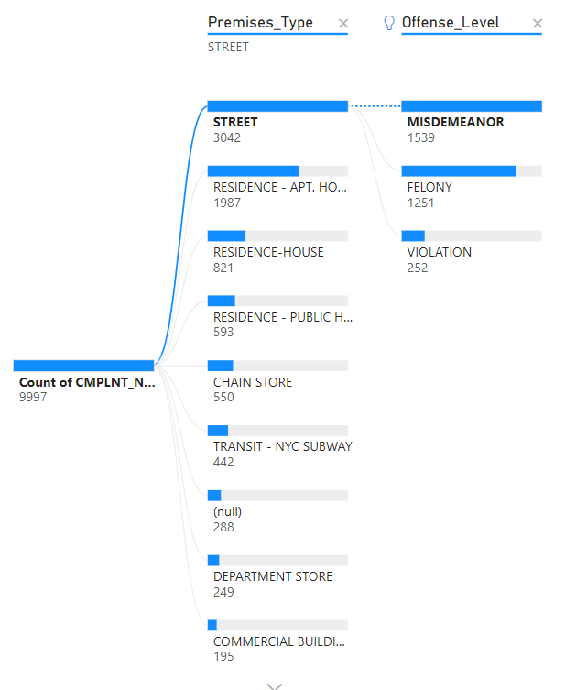
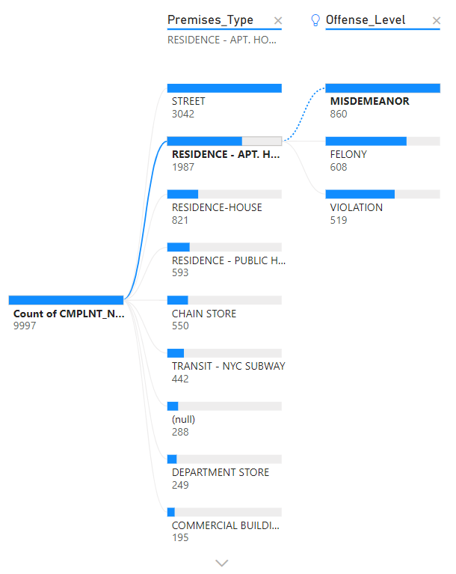
Data Understanding
These figures show the type of premises in which the offence had occurred, and the diverse types of offences and their numbers within the selected premises. It can be observed that, the greatest number of offences have occurred in the streets, the least number were committed in commercial buildings. It should also be noted that misdemeanor offences were the highest number of offences irrespective of the premises of the offence.

Slide 14
Data Preparation

Slide 15
Data Preparation
NYPD complaint dataset contain 36 attributes and 433,280 rows of data.
Filtered data to select only 2024 data.
Relevant attribute 15 attributes.
Sample data to randomly pick 10,000 rows.

Slide 16
Data Preparation
Selected Attribute
Require Preparation | Does not require preparation
Precinct_Code | Crime_Completion_Status
Start_Date | Jurisdiction_Description
Report_Date | Offense_Description
Borough | Offense_Level
Victim_Age_Group | Victim_Sex
Victim_Race | Patrol_Borough
Start_Time
Latitude
Longitude

Slide 17
Data Preparation
Data Cleaning
Missing values:
Had two attributes i.e. Longitude and Latitude that contain missing values.
Remove Duplicate:
In 10,000 rows of data there is a good chance of having duplicate rows might affect our predictions.
Removed 4 duplicate rows from our data.

Slide 18
Data Preparation
Data Cleaning
3. Incorrect Data:
Borough and Victim_Race had null values which was not replaced by replacing missing values operator was replaced manually using Map operator.
Same with Victim_Age_Group, had ‘-965’ as value in age column, replaced by the most occurring value in that column.

Slide 19
Data Preparation
Construct Data
Constructed 3 new attributes from existing 4 attributes.
AgeGroup_Victim from Victim_Age_Group.
Time_Group from Start_Time.
Location from Longitude and Latitude.
The old attributes were removed from the data.

Slide 20
Data Preparation
Construct Data
AgeGroup_Victim:
Victim_Age_Group | AgeGroup_Victim
<18 | Child
18-24 | Young Adult
25-44 | Adult
45-64 | Middle-aged Adult
65+ | Senior
UNKNOWN | UNKNOWN

Slide 21
Data Preparation
Construct Data
Time_Group
Start_Time | Time_Group
00:00:00 – 04:59:59 | Late Night
05:00:00 – 11:59:59 | Morning
12:00:00 – 16:59:59 | Afternoon
17:00:00 – 20:59:59 | Evening
21:00:00 – 23:59:59 | Night

Slide 22
Data Preparation
Construct Data
Location:
Location | Latitude | Longitude
Group1 | 40.50 - 40.55 | -74.25 to -74.20
Group2 | 40.50 - 40.55 | -74.20 to -74.15
Group3 | 40.50 - 40.55 | -74.15 to -74.10
Group4 | 40.50 - 40.55 | -74.10 to -73.80
Group5 | 40.55 - 40.60 | -74.25 to -74.20
Group6 | 40.55 - 40.60 | -74.20 to -74.15
Group7 | 40.55 - 40.60 | -74.15 to -74.10
Group8 | 40.55 - 40.60 | -74.10 to -73.80
Group9 | 40.60 - 40.65 | -74.25 to -74.20
Location | Latitude | Longitude
Group10 | 40.60 - 40.65 | -74.20 to -74.15
Group11 | 40.60 - 40.65 | -74.15 to -74.10
Group12 | 40.60 - 40.65 | -74.10 to -73.80
Group13 | 40.65 - 40.70 | -74.25 to -74.20
Group14 | 40.65 - 40.70 | -74.20 to -74.15
Group15 | 40.65 - 40.70 | -74.15 to -74.10
Group16 | 40.65 - 40.70 | -74.10 to -73.80
Group17 | 40.70 - 41.00 | -74.25 to -73.80
Error | Any other range | Any other range

Slide 23
Data Preparation
Format Data
Attribute | Conversion
Start_Date | Date-time to Numeric (days of the week)
Report_Date | Date-time to Numeric
Precinct_Code | Numerical to Nominal
Report_Date | Numerical to Nominal
Start_Date | Numerical to Nominal

Slide 24
Modeling

Slide 25
Modeling
Algorithms used: Decision Tree, Random Forest, and kNN.
Performance metrics: accuracy, precision, and recall.
Confusion matrices and key findings.

Slide 26
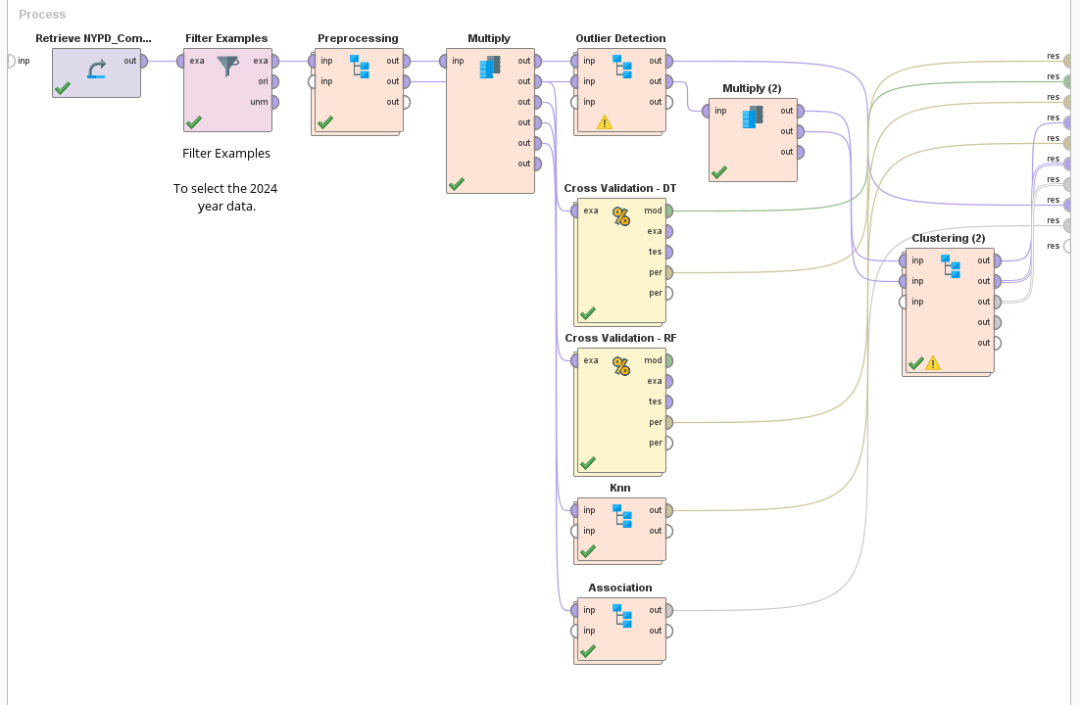
Modeling

Slide 27
Decision Tree
Introduction
Definition: Decision Tree is a supervised machine learning technique used for classification and regression tasks by splitting data into branches based on feature values.
Purpose: Provides a clear, interpretable model for making predictions or decisions.
Benefits: Easy to understand and visualize, handles both numerical and categorical data, and captures non-linear relationships effectively.

Slide 28
Decision Tree
Data Preparation
Selected Attribute: AgeGroup_Victim, Borough, Crime_Completion_Status, id, Jurisdiction_Description, Location, Offense_Description, Offense_Level, Patrol_Borough, Precinct_Code, Report_Date, Start_Date, Time_Group, Victim_Race, Victim_Sex.
No additional data preparation is required for the decision tree.

Slide 29
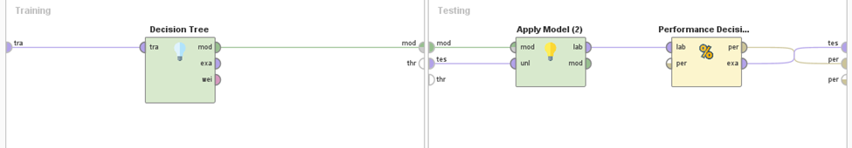
Decision Tree
Modeling

Slide 30
Decision Tree
Cross Validation: Splits the data into training and testing subsets to evaluate model performance while preventing overfitting.
Decision Tree Operator: Builds the decision tree model by learning patterns from the training data, identifying optimal splits based on the chosen criteria
Apply Model: Applies the trained decision tree model to the testing dataset to generate predictions.
Performance Operator: Evaluates the model's accuracy and other metrics, such as precision, recall, and F1-score, to assess its effectiveness.

Slide 31
Random Forest
Introduction
Definition: Random Forest is an ensemble machine learning technique that builds multiple decision trees and combines their outputs for more accurate and stable predictions.
Purpose: Improves prediction accuracy and reduces overfitting by aggregating results from multiple trees.
Benefits: High accuracy, robustness to noise, handles both classification and regression, and works well with large datasets.

Slide 32
Random Forest
Data Preparation
Selected Attributes are same as Decision Tree.
No additional data preparation is required for the Random Forest.

Slide 33
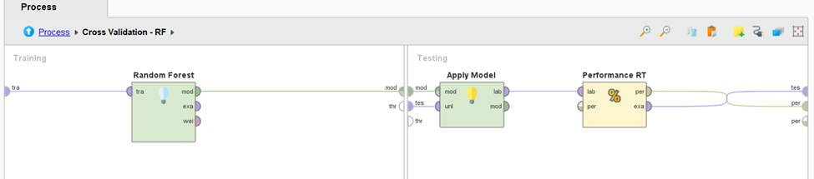
Random Forest
Modeling

Slide 34
Random Forest
Cross Validation: Divides the dataset into training and testing subsets to evaluate model performance, ensuring reliable and unbiased results.
Random Forest Operator: Constructs a collection of decision trees (ensemble) using random subsets of data and features, providing robust predictions and minimizing overfitting.
Apply Model: Uses the trained Random Forest model to make predictions on new or unseen data.
Performance (Random Forest): Computes key evaluation metrics, such as accuracy, precision, recall, and F1-score, to assess the model's effectiveness.

Slide 35
KNN
Introduction
Definition: K-Nearest Neighbors (KNN) is a supervised machine learning algorithm that classifies data points based on the majority class of their closest neighbors.
Purpose: Provides a simple and effective method for classification and regression tasks by leveraging proximity-based similarity.
Benefits: Easy to implement, no training phase required, adaptable to non-linear data, and works well with small datasets.

Slide 36
KNN
Data Preparation
Data Selection:
AgeGroup_Victim, Borough, Crime_Completion_Status, id, Jurisdiction_Description, Location, Offense_Description, Offense_Level, Patrol_Borough, Time_Group, Victim_Race, Victim_Sex.

Slide 37
KNN
Data Preparation
Data Conversion:
All the selected attributes were converted from nominal to numerical data.
Split data into 70:30 ratio.

Slide 38
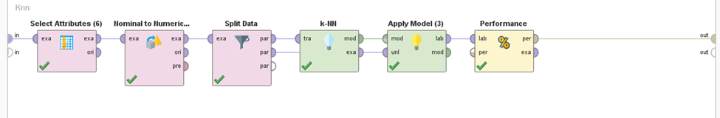
KNN
Modeling

Slide 39
KNN
Nominal to Numerical: Converts categorical data into numerical format, ensuring compatibility with the kNN algorithm.
Split Data: Divides the dataset into training and testing subsets to evaluate the model's performance.
kNN Model: Implements the k-Nearest Neighbors algorithm, where the optimal K value is selected for accurate predictions.
Performance (kNN): Assesses the model's accuracy and other metrics, providing insights into its effectiveness on test data.

Slide 40
Clustering
Introduction
Definition: Clustering is an unsupervised machine learning technique for grouping similar data points.
Purpose: Simplifies complex datasets by identifying natural groupings.
Used Algorithm: K-Means.
Benefits: Reveals hidden patterns, aids decision-making, and provides actionable insights.

Slide 41
Clustering
Data Preparation
Data Selected: AgeGroup_Victim, Borough, Crime_Completion_Status, Jurisdiction_Description, Location, Offense_Description, Offense_Level, Patrol_Borough, Precinct_Code, Report_Date, Start_Date, Time_Group, Victim_Race, Victim_Sex.
Data conversion: All attributes were converted from nominal to numerical.

Slide 42
Clustering
Modeling
Loop Parameter: Automatically tests different numbers of clusters to find the optimal K using the Elbow Method.
Clustering Operator: Implements the best K i.e. 11 value to get best result.
Aggregate: Summarizes clustering results for evaluation.
Join and Filter Examples: Combines and refines the data for deeper analysis.

Slide 43
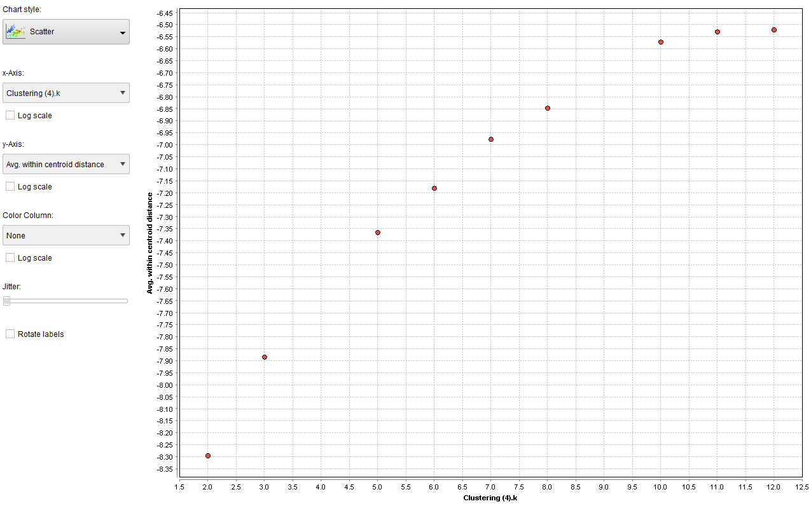
Clustering
Elbow Point

Slide 44
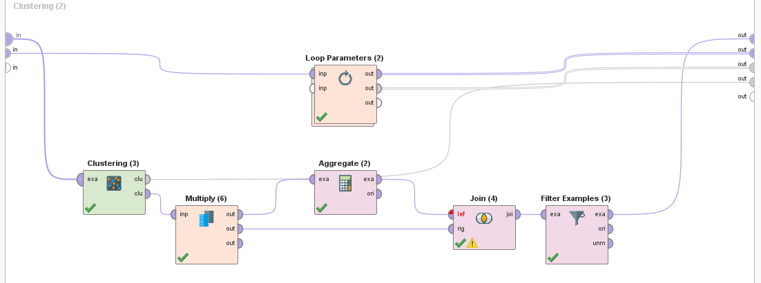
Clustering
Modeling

Slide 45
Association
Introduction
Definition: Association is an unsupervised machine learning technique used to discover interesting relationships or patterns between variables in large datasets, often used for market basket analysis.
Purpose: Identifies frequent itemsets and association rules, helping to uncover hidden patterns or associations in data.

Slide 46
Association
Introduction
Used Algorithm: Apriori, FP-Growth.
Benefits: Reveals valuable insights for decision-making, such as product recommendations, customer behavior analysis, and inventory management.

Slide 47
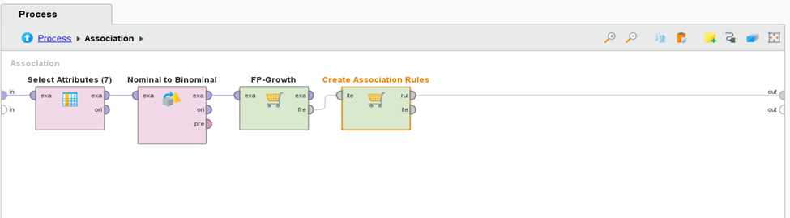
Association
Modeling

Slide 48
Association
Modeling
Construct FP-tree based on item frequency.
Extract frequent itemsets from the FP-tree.
Identify relationships between items based on support and confidence.

Slide 49
Outlier Detection​

Slide 50
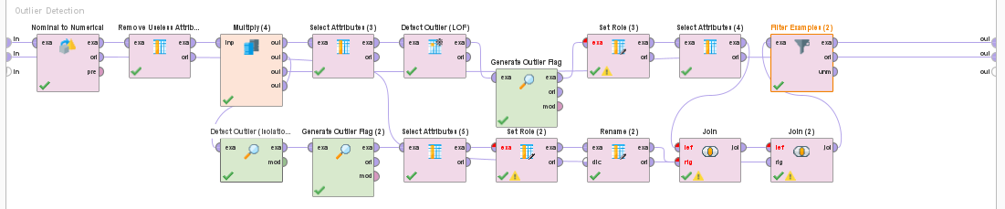
Outlier Detection
Introduction & Importance
Outlier detection identifies anomalies in crime data that could indicate emerging threats or data issues.
Techniques used: Local Outlier Factor (LOF) and Isolation Forest.
Important for proactive crime prevention and resource allocation.

Slide 51
Outlier Detection
(LOF) Local Outlier Factor Overview
• LOF compares data points' density to that of their neighbors.
• It identifies points that are significantly different from the surrounding data.
• Helps detect emerging crime trends or anomalies in location and time.

Slide 52
Outlier Detection
(ISF) Isolation Forest Overview
• Isolation Forest isolates outliers by partitioning data randomly.
• It works by recursively splitting the data to create isolated subspaces for anomalies.
• Ideal for identifying rare events that do not conform to typical patterns.

Slide 53
Outlier Detection
Application in Crime Data
•The Local Outlier Factor (LOF) and The Isolation Forest successfully flagged 5% of records as anomalies, aligning with expected outlier rates.
•LOF (Local Outlier Factor) was effective in flagging unusual crime incidents based on their density in time or location. The method allowed us to identify instances that deviated from typical crime patterns.
•We detected irregularities, such as crimes in typically low-crime areas or at unusual times. These outliers suggest that some incidents may warrant further investigation, as they do not conform to the usual patterns of crime distribution in the region.

Slide 54
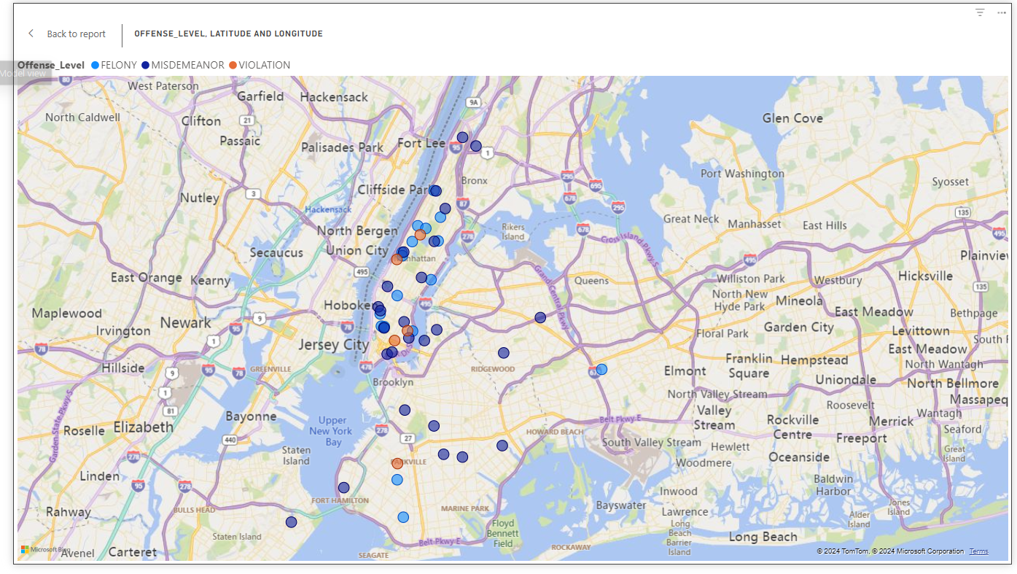
Outlier Detection
Map Visualization of Implication
Felony offenses (represented by blue dots) are more concentrated in specific neighborhoods, while Misdemeanors (orange) and Violations (purple) appear scattered across a wider area.
Higher concentration of offenses in central urban areas such as Manhattan and Brooklyn, with fewer incidents reported in more suburban and rural areas. This pattern is likely due to factors such as higher population density and more frequent interactions with law enforcement.
The outliers, which are located in less densely populated regions, indicates lower crime rates in these areas, potentially due to better community cohesion or more effective crime prevention strategies.

Slide 55
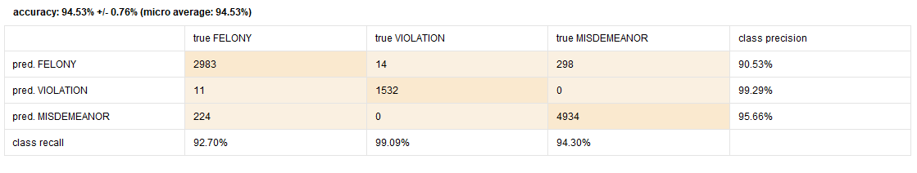
Discussion of Results
Result for Decision Tree

Slide 56
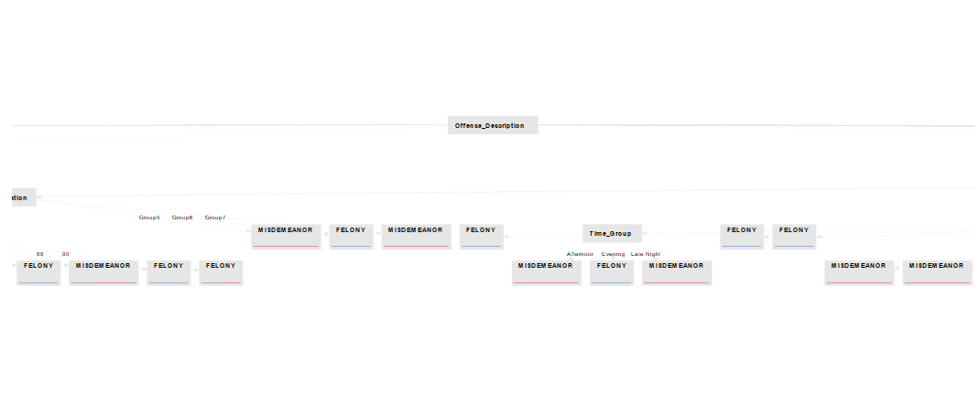
Discussion of Results
Result for Decision Tree

Slide 57
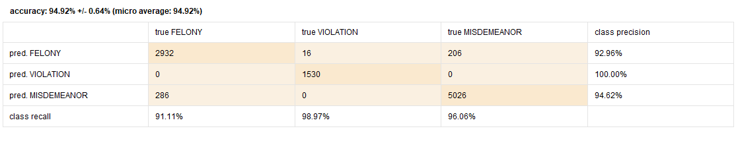
Discussion of Results
Result for Random Forest

Slide 58
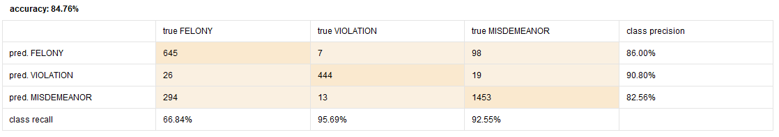
Discussion of Results
Result for KNN

Slide 59
Discussion of Results
Result for Association
Bronx-Specific Patterns with Location Grouping
Consistent Bronx Patterns:
[Borough = BRONX] --> [Location = Group17, Patrol_Borough = PATROL BORO BRONX] (Confidence: 0.999).
Indicates all Bronx incidents are consistently marked under Location = Group17 and linked to PATROL BORO BRONX.
Implication: Group17 may serve as a categorical or hotspot label for Bronx-specific cases.

Slide 60
Discussion of Results
Result for Association
Perfect Association Between Group17 and Bronx Incidents
Unique Data Grouping for Bronx:
[Location = Group17, Borough = BRONX] --> [Patrol_Borough = PATROL BORO BRONX] (Confidence: 1.000).
Insight: This rule reflects a highly consistent grouping method for Bronx incidents, potentially indicating a specialized patrol or operational region.

Slide 61
Discussion of Results
Result for Association
Patterns Across Manhattan and Other Boroughs with Group17
Broader Application of Group17:
[Borough = MANHATTAN] --> [Location = Group17] (Confidence: 1.000).
Suggests Group17 may represent a larger geographical scope, encompassing Bronx and Manhattan.

Slide 62
Conclusion
Crime Trends & Hotspots
Identified high-crime areas (Bronx, Brooklyn) and peak crime times using Random Forest & Decision Tree.
Anomaly Detection
Detected 5% anomalies, uncovering rare events and data inconsistencies.
Modeling Performance
Random Forest: 94.98% accuracy, excellent precision for violation predictions.
K-Means: Identified 23 optimal crime clusters with good clustering quality.

Slide 63
Conclusion
Key Challenges & Solutions
Improved data quality through imputation and preprocessing.
Addressed imbalanced data with tuning and cross-validation.
Recommendations
Enhance data quality with real-time validation and automated checks.
Integrate external datasets (socio-economic, weather) for deeper insights.
Implications
Optimized law enforcement resource allocation based on crime hotspots and time trends.
Improved decision-making with actionable insights for crime prevention strategies.

Slide 64
Q & A
ANY
Questions?

Slide 65
THANK
You

